Slide 1
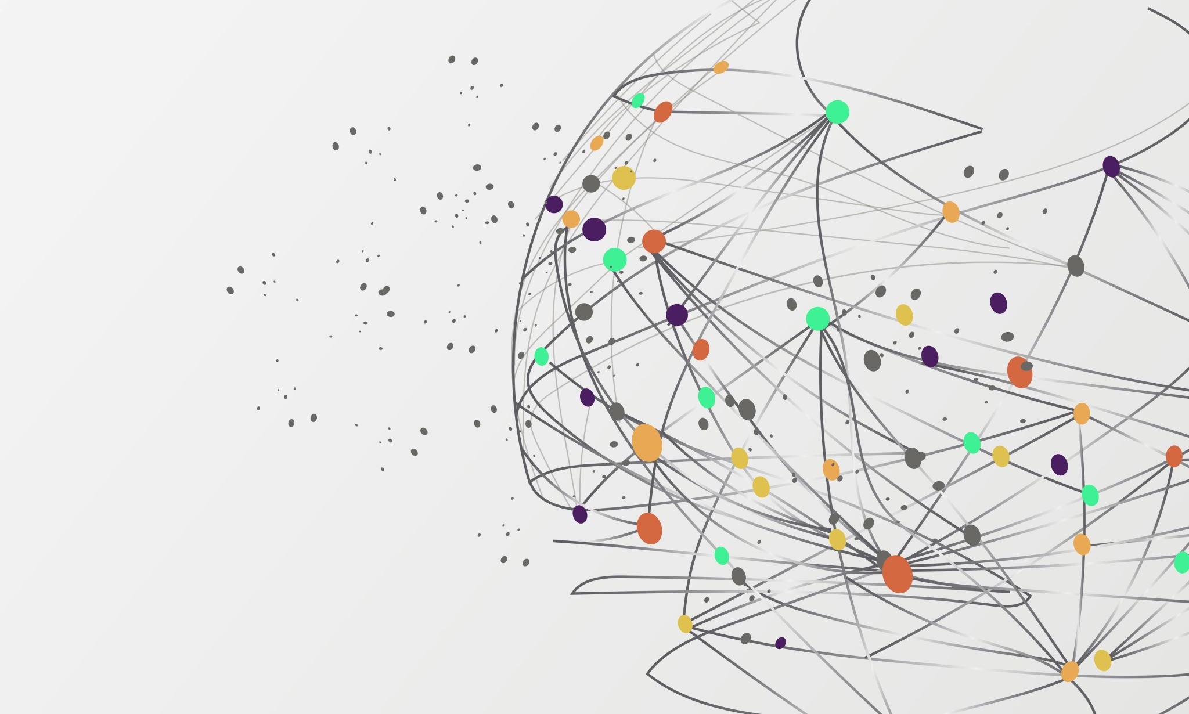
Laptops Price Predictions
- Babu Penosh Gorla (E24004)
- Brahmi Rathod (E24005)
- Harshavardhan Rimmanpudi (E24007)

Slide 2

Problem statement
In today's dynamic market, it is increasingly challenging to objectively quantify the value of a product based solely on its features.
Factors such as brand perception, marketing strategies, and consumer trends can significantly influence a product's price, often leading to a discrepancy between its fair value and its hyped value.
This project aims to develop a predictive model that not only estimates the fair value of a product based on its intrinsic features but also identifies and explains the gap between the fair value and the market-driven hyped value.

Slide 3
Project Flow
Extracting data using webscraping
Storing the extracted data
Transforming
Model building
Deployment

Slide 4
Azure Architecture
Azure Data Factory – (CI/CD pipeline)
Azure Function app – (serverless app)
Azure data lake – (storage)
Data flow – (Data preprocessing and ETL)
Azure Machine Learning – (model building and deployment)

Slide 5
Extracting Data from E-commerce Website and SQL Database
Objective: Collect relevant data on laptop prices.
Tools Used: Python, BeautifulSoup, Selenium, Azure function app.

Slide 6
Web Scraping through Azure Function App
Serverless compute service to run scripts.
Triggering web scraping tasks.
Handling large-scale data extraction.

Slide 7

Loading Data into Data Lake
Scalable storage repository that holds vast amounts of raw data.
Storing the extracted data.
Ensuring data is accessible for processing.

Slide 8
Preprocessing the Data using Data Flow
Data Flow: ETL (Extract, Transform, Load) process.
- Data Cleaning: Handling missing values, removing duplicates.
- Data Transformation: Normalizing and structuring data.
- Data Enrichment: Adding calculated fields or aggregating data.

